Slide 1


Slide 2
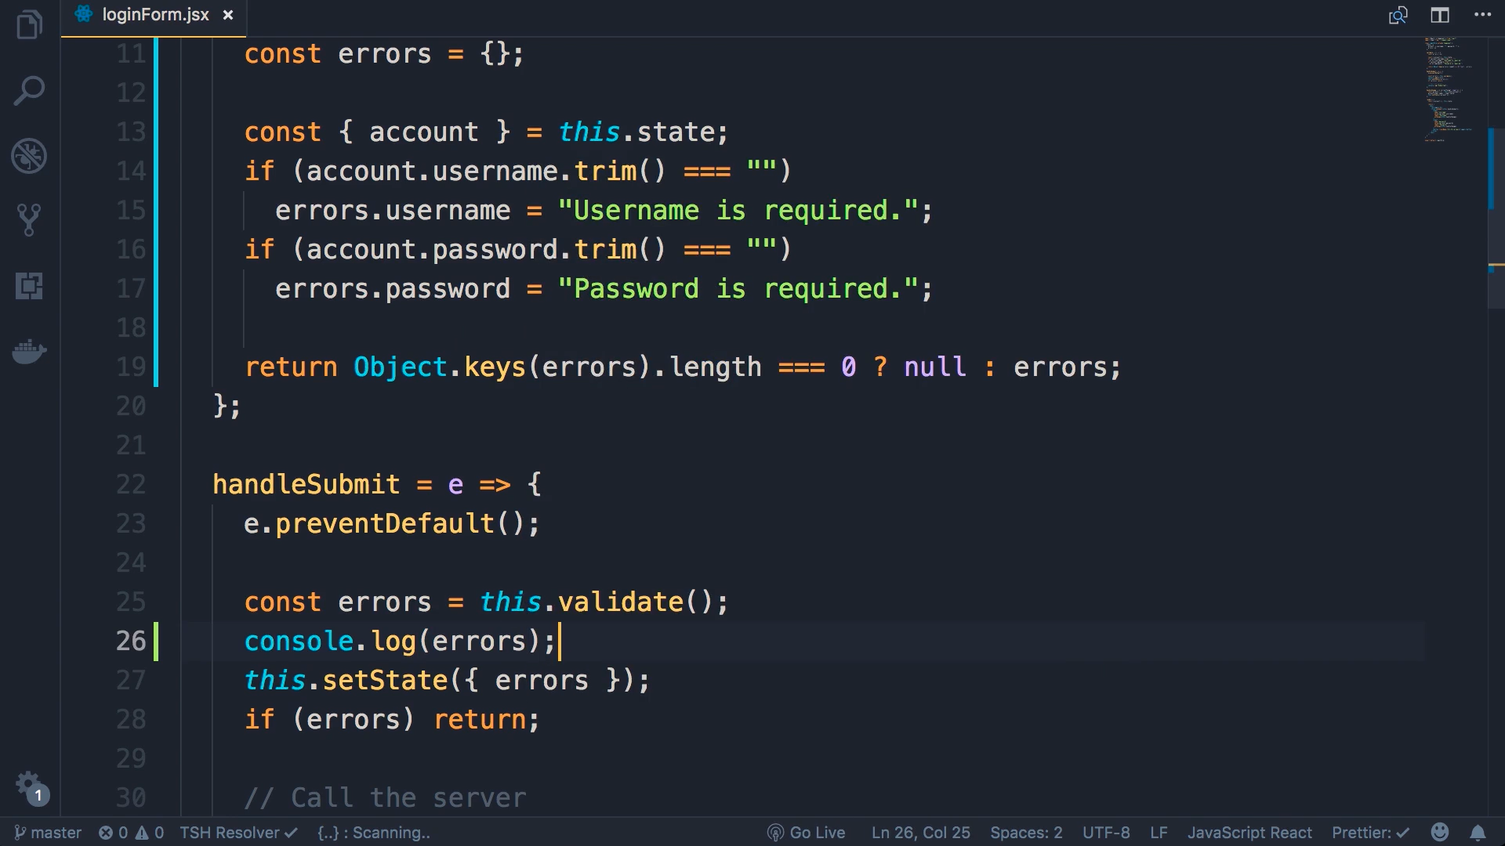
In the validate method write from 11

Slide 3
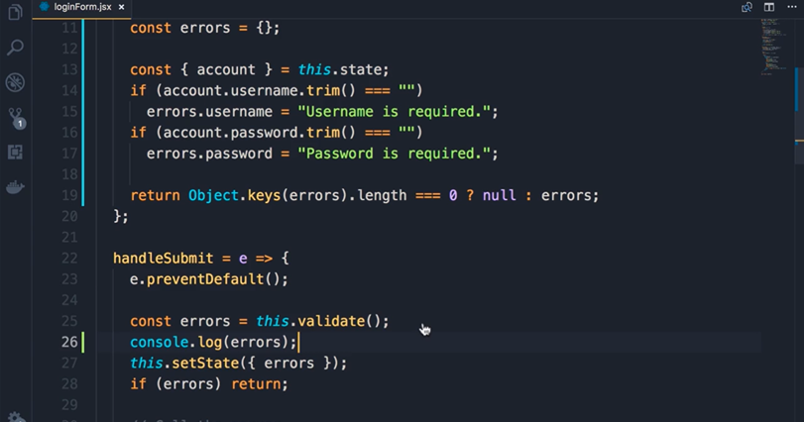
Call validate in handleSubmit and console.log(errors)

Slide 4
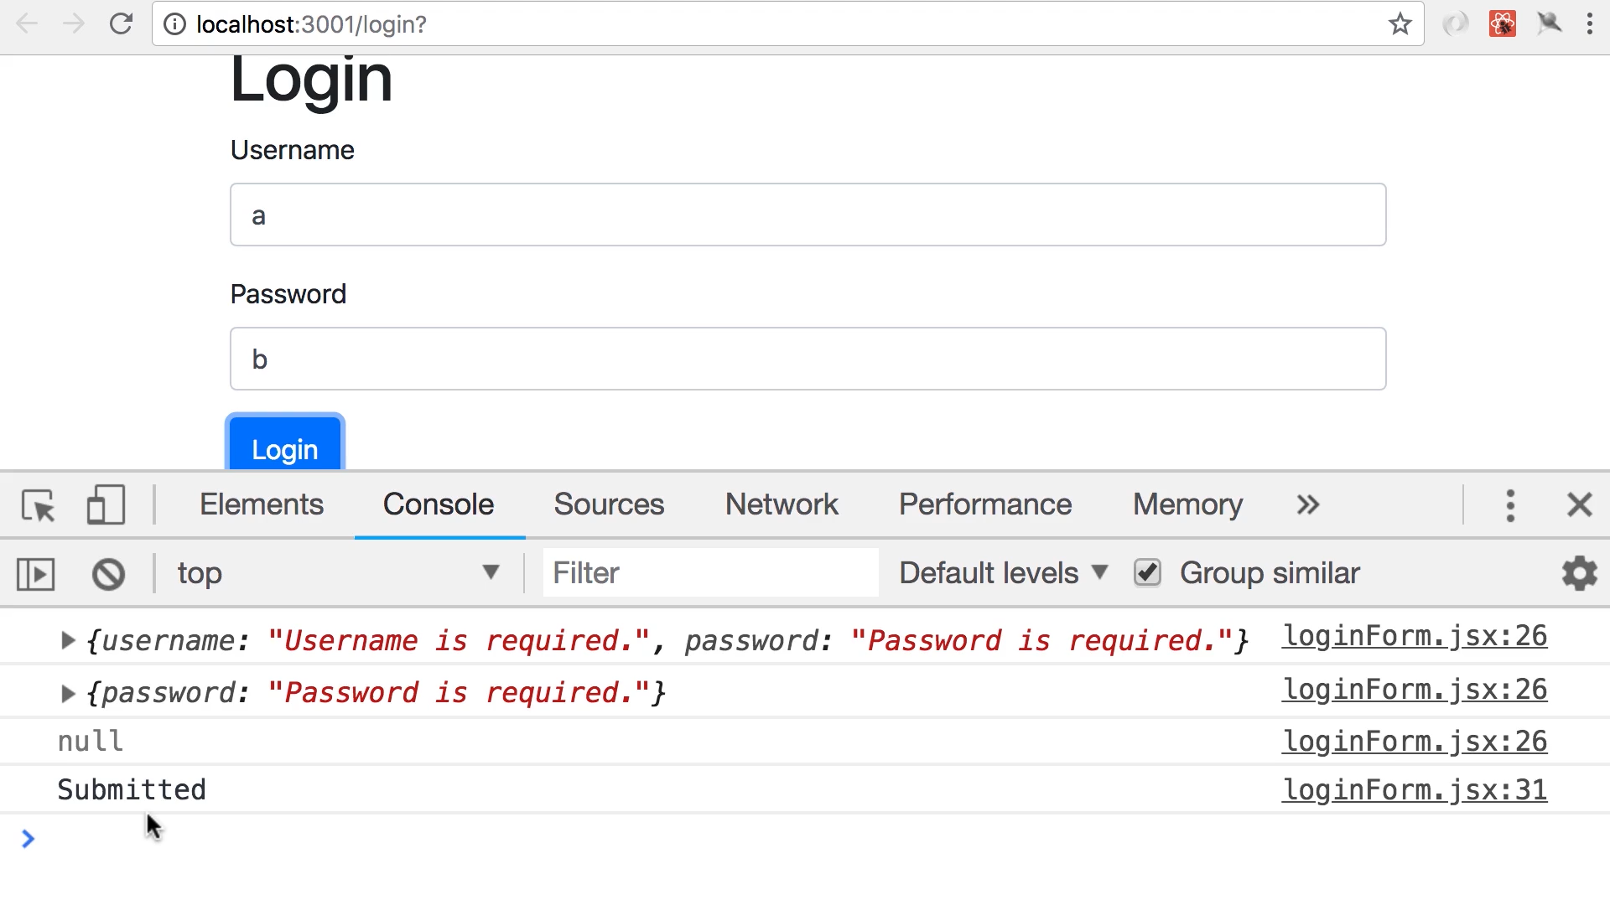
Click

